Slide 1


Slide 2
BILLBOARD

Slide 3
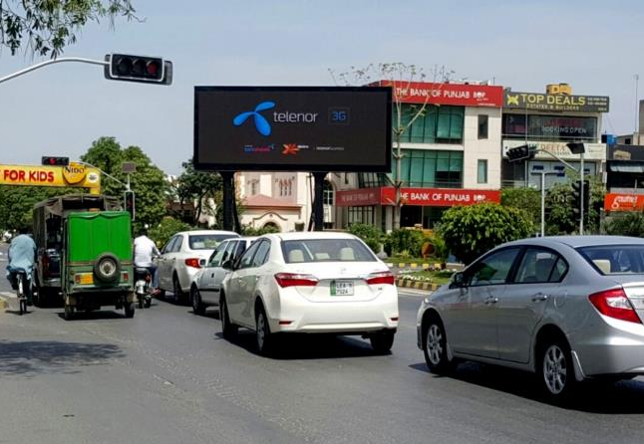
LAHORE
40ft x 20ft
Digital Billboard
1
Opposite Mcdonald, Y /Z Block, DHA
(Rate Per slot 30 sec)
FTCF Y Block Main Market, Phase 4, 5 & 6
TCF Main Boulevard, City Area
STA
30 Days
950,000
00000
00000

Slide 4
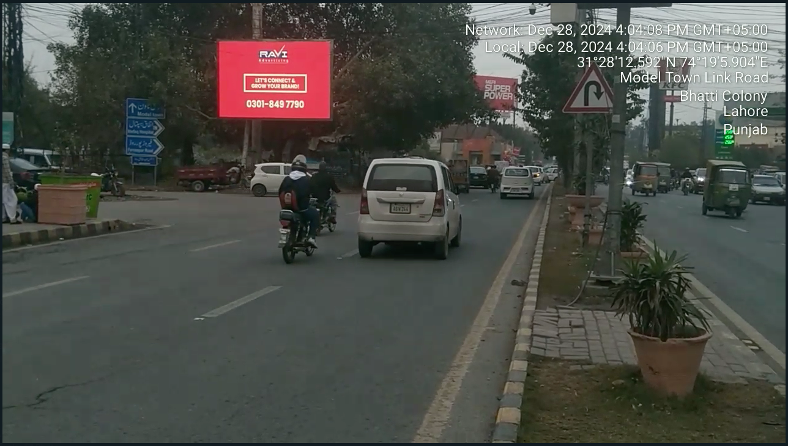
LAHORE
22ft x 13ft
Digital Billboard
1
Infront Of Pace Mall, Link Road, Model Town/KFC & Metro C&C (Rate Per slot 30 sec)
FTCF: Peco Road, Akbar Chowk , Jinnah Hospital
TCF: Model Town Society & Model Town Underpass & Ferozepur Road
STA
30 Days
500,000
00000
00000

Slide 5
STREAMERS

Slide 6
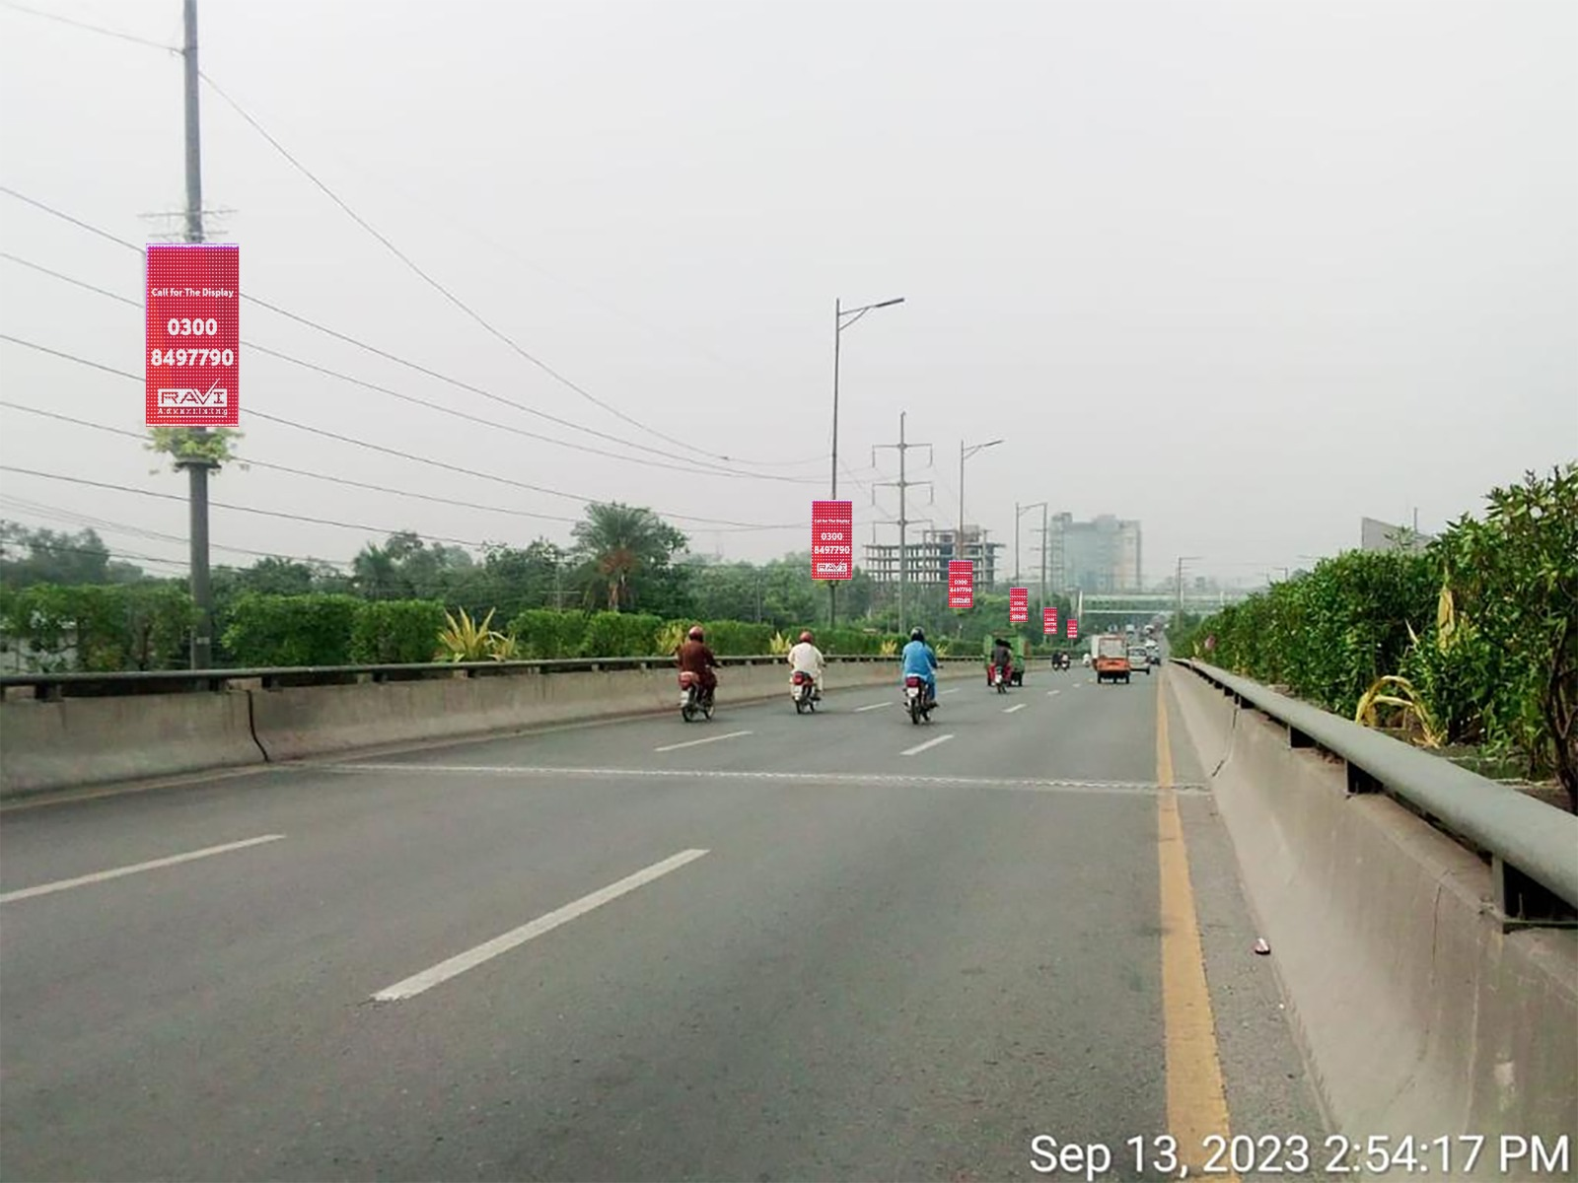
Lahore
3x6
Digital Streamers
36
Kalma Chowk Flyover
(Rate Per slot 15 sec)
FTCF: Arfa Karim Tower / Qainchi Flyover
TGT: Muslim Town, Ichra
STA
7 Days
350,000
00000
00000

Slide 7
Pylons

Slide 8
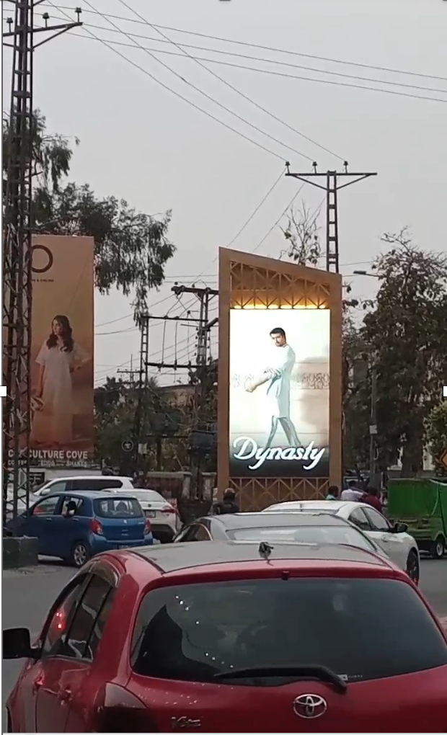
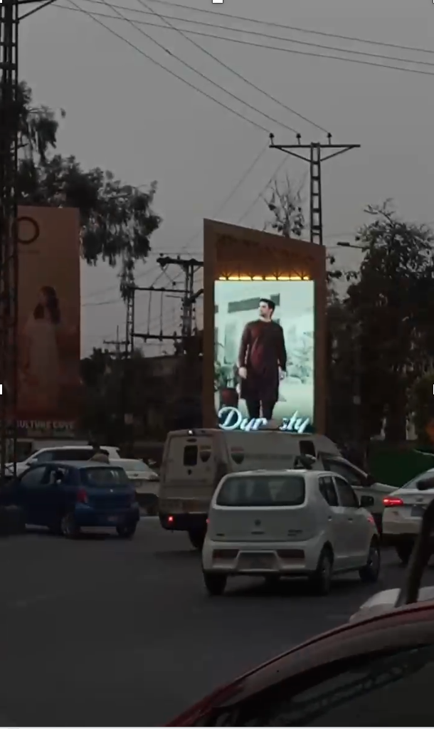
Lahore
9 x 16
Digital Pylons
1
Mini Market R/A
(Rate Per slot 15 sec)
MM Alam Road towards Hussain Chowk
STA
7 Days
60,000/-
00000
00000

Slide 9
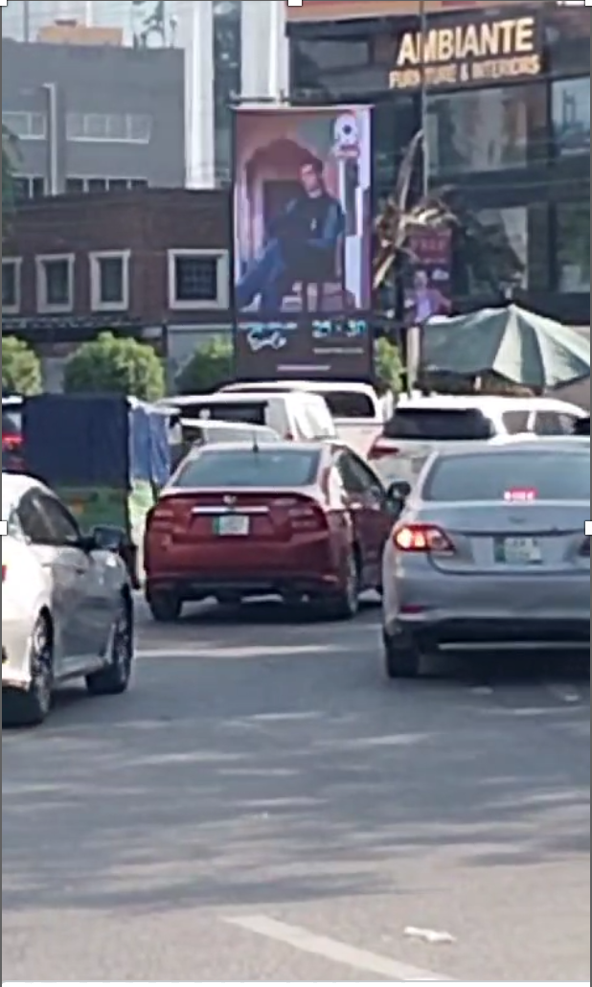
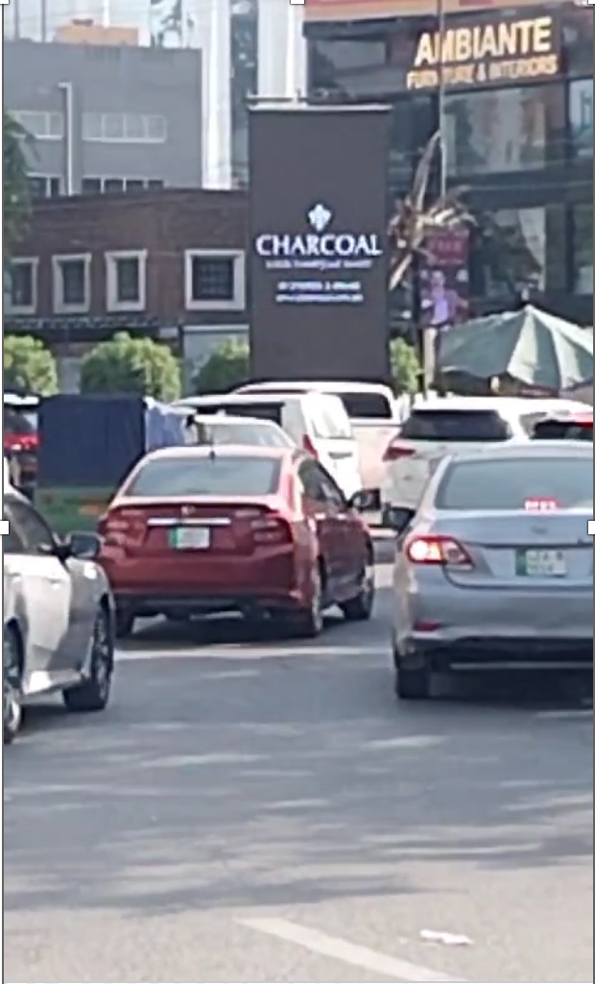
Lahore
7 x 14
Digital Pylons
1
Hussain Chowk R/A
(Rate Per slot 15 sec)
Towards Firdous Market
Towards Noor Jahan Road
MM Alam Road towards Mini Market
STA
7 Days
50,000/-
00000
00000

Slide 10




STREAMERS
Multan

Slide 11
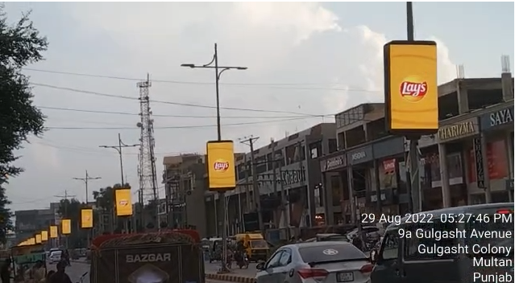
Multan
3x6
Digital Streamers
54
GULGUSHAT AVENUE, PIZZA HUT ROAD (Rate Per slot 15 sec)
FTCF: GOAL BAGH, GARDEZI MARKET, PIZZA HUT, TEHSIL CHOWK, BOSAN ROAD
TGT: TEHSIL CHOWK, PIZZA HUT, GARDEZI MARKET, GOAL BAGH, BOSAN ROAD
STA
7 Days
250,000
00000
00000

Slide 12
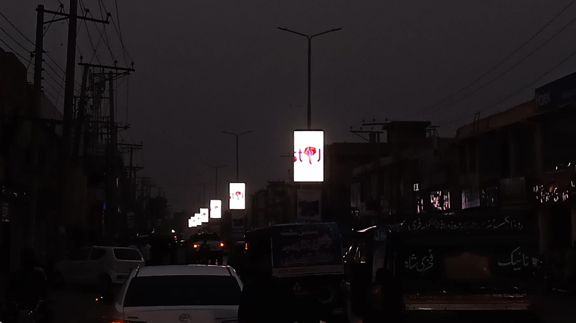
Multan
3x6
Digital Streamers
16
KHAN PLAZA, AZIZ BHATTI ROAD, CANTT (Rate Per slot 15 sec)
FTCF: MULTAN CITY, CANTT AREA, SP CHOWK, KHAN PLAZA, MALL PLAZA, IMPERIAL CHOWK, ABDALI ROAD, QASIM ROAD
TGT: MULTAN CITY, CANTT AREA, SP CHOWK, KHAN PLAZA, MALL PLAZA, IMPERIAL CHOWK, ABDALI ROAD, QASIM ROAD
STA
7 Days
200,000
00000
00000

